Slide 1
An Introduction to WorkSource Operational Standards
Fall 2015
Notes:
Welcome Introductions of audience
Outline the presentation
Introduce self

Slide 2
Customer-Centric
: someone who buys goods or services
from a business
: in the middle of something
: located in the center of a thing or place
: main or most important
Notes:
This is WSO Standards in two words:
Customer: we provide services
Centric – from the word Central which means
This is a theme throughout WIOA and WSO Standards

Slide 3
Roles & Responsibilities
Oregon Workforce Investment Board
The Board is tasked with developing a plan for statewide workforce investment system and assisting the Governor in developing Oregon’s workforce system.
Local Workforce Boards
Provide a convening table for labor, economic development, elected officials, education, workforce development and human service providers to create local solutions in response to the needs of the workforce and business.
Local Leadership Teams
The mechanism used to manage the implementation of the local WSO system.
Notes:
Something to look at before the presentation starts.
Word cloud created by Wordle.com

Slide 4
Background
WSO system integration began in October 2008.
Goals at that time included:
Co-location of multiple partners within WorkSource Oregon.
The Oregon Employment Department and Title 1 service providers working to define and deliver an agreed-upon set of jobseeker services in WorkSource Oregon.
Business recognized as the primary customer and services better aligned.
WorkSource leadership reaffirmed their commitment to integration at that same time Workforce Innovation Opportunity Act was being drafted. System leadership aligned our integration efforts with new system expectations from WIOA.
WorkSource leadership needed to reaffirm their commitment to system integration because not all areas of the state fully implemented the original integration effort.
With the new law and a new oversight role for the state workforce board, we believe all centers will be on board and meeting the standards.

Slide 5
MISSION To effectively respond to workforce challenges through high-quality services to individuals and businesses, resulting in job attainment, retention and advancement.
VISION
Communities where the employment needs of jobseekers and businesses are met by solutions delivered effectively through engaged workforce system partners.
Notes:
Why is a mission/vision statement important for WorkSource Oregon?
Unifies various partners with their own agency-based mission, vision, values.
This should be what we all strive to be/accomplish.
You’ll hear these themes throughout the WSO Standards presentation.

Slide 6
Foundations of Service Delivery
Sector Strategies
The terms industry “sector” and “cluster” are often used interchangeably. Industry cluster typically describes the entire value chain of a broadly defined industry from suppliers to end products. Sector is a term more widely used in workforce development, defining an industry primarily by common workforce needs and occupations.
Labor Market Information
LMI will inform sector strategies, career planning, training decisions, business engagement and placement services.
Continuity of Services
The goal is to provide the best customer-focused service possible through a continuity of services that are not dependent upon a customer returning to the same staff person.
Feedback Mechanisms
All centers will develop feedback mechanisms to ensure that services are driven by and are meeting business needs, and to ensure that internal teams are operating on the same information and striving toward the same local expectations. Feedback mechanisms will be documented and locally tracked to ensure effectiveness of service provision.

Slide 7
Workforce Innovation and Opportunity Act
To achieve and maintain an integrated, job-driven workforce system that links our diverse, talented workforce to our nation’s businesses and improves the quality of life for our citizens.
Based on three key pillars of our system:
One-Stop career centers provide first-rate customer service to jobseekers, workers, and businesses.
The demands of businesses and workers drive workforce solutions.
The workforce system supports strong regional economies.
WIOA
Notes:
Three key pillars of our system (WIOA and WSO)
First-rate customer service
Business and workers drive demand
WSO supports strong regional economies
These themes are repeated throughout the WSO Standards.

Slide 8
What are the WSO Standards?
74 Operational Standards
Business and Job Seekers drive the business
Continues to integrate and align system resources
Improves customer service at WorkSource
Operational and Technology standardization across the state
Local areas create the “how”
Strong state-level of support for local areas

Slide 9
System Standardization
CO-LOCATION
In order to be designated as a WorkSource Oregon center, Wagner-Peyser employment service offices must be co-located with Title I one-stop centers.
ALIGNMENT OF SERVICES
In order to be designated as a WorkSource Oregon center, services among Wagner-Peyser and Title I staff will be aligned, resulting in seamless provision of services to customers.
BRANDING
WorkSource Oregon branding standards for professional appearance of WSO Centers and WSO staff.
TECHNOLOGY INFRASTRUCTURE
All WorkSource Oregon centers will maintain a standard level of technology to ensure comparable access to automated services for customers.
Notes:
ROBERT
74 Standards
62 for Centers
12 for System
CO-LOCATION
In order to be designated as a WorkSource Oregon center, Wagner-Peyser employment service offices must be co-located with Title IB one-stop centers. Plans will be developed and transitions in progress for all communities no later than July 2015. These transition processes will be complete no later than July 1, 2016.
ALIGNMENT OF SERVICES
In order to be designated as a WorkSource Oregon center, services among Wagner-Peyser and Title IB staff will be aligned resulting in seamless provision of services to customers. Total staff resources across both funding streams will be pooled together and allocated collectively to ensure all services are delivered in accordance with the requirements of these operational standards. All operational functions, including supervision and management where appropriate, will be taken into consideration when developing a functional staffing plan for each center. Agreed-upon staffing plans (including methodology, roles and expectations) will be documented and may be solicited during program monitoring. All centers that are currently co-located will be compliant with Alignment of Services criteria no later than July 1, 2015. All WSO centers will have Alignment of Services in place by July 1, 2016.
BRANDING
WorkSource Oregon (WSO) is the accepted brand for WorkSource Oregon centers. All centers will adopt and execute this brand, in accordance with the Oregon Workforce Investment Board decisions from September 2007 and December 2008. The brand is applicable to all signage, center décor, lobby/resource room kiosks, brochures, print materials, marketing materials, name tags, web and social media presence, business cards, e-mail signature blocks, telephone protocols, and other related applications for all WSO-funded activities and functions provided through the WSO centers.
Each LLT will establish protocols to ensure that physical structures are kept clean, neat, professional, and reflective of an aligned and integrated environment. Additionally, LLTs will develop center/local area-specific professional standards which include expectations for acceptable work apparel. All sub-contractors providing WSO-funded services through the centers must comply with these branding standards and any additional local protocols established by LLTs. These will be established no later than July 1, 2016.
In addition to WorkSource Oregon, WIOA requires that the Secretary of Labor establish a common one-stop delivery system identifier. The identification requirements will be determined no later than July 1, 2016.
TECHNOLOGY INFRASTRUCTURE
All WorkSource Oregon centers will maintain a standard level of technology to ensure comparable access to automated services for customers. A gap analysis of technology needs across the state will be completed by July 1, 2015, with all centers equipped with standardized technology infrastructure by July 1, 2016.

Slide 10
System Standardization
Branding includes establishing an open floor plan
for each center that features:
An open environment allows for ease of service from staff to customer throughout the room.
Barriers do not separate the public computers; instead, computers are in the center of the office – providing accessibility to customers and ensuring that staff are aware of customers’ needs.
Cubicle walls for staff are lowered for complete visibility.
A greeter station will take the place of the standard reception desk and will look more like a podium. This person will greet the public and determine next steps for service.
Notes:
Danell
CO-LOCATION
In order to be designated as a WorkSource Oregon center, Wagner-Peyser employment service offices must be co-located with Title IB one-stop centers. Plans will be developed and transitions in progress for all communities no later than July 2015. These transition processes will be complete no later than July 1, 2016.
ALIGNMENT OF SERVICES
In order to be designated as a WorkSource Oregon center, services among Wagner-Peyser and Title IB staff will be aligned resulting in seamless provision of services to customers. Total staff resources across both funding streams will be pooled together and allocated collectively to ensure all services are delivered in accordance with the requirements of these operational standards. All operational functions, including supervision and management where appropriate, will be taken into consideration when developing a functional staffing plan for each center. Agreed-upon staffing plans (including methodology, roles and expectations) will be documented and may be solicited during program monitoring. All centers that are currently co-located will be compliant with Alignment of Services criteria no later than July 1, 2015. All WSO centers will have Alignment of Services in place by July 1, 2016.
BRANDING
WorkSource Oregon (WSO) is the accepted brand for WorkSource Oregon centers. All centers will adopt and execute this brand, in accordance with the Oregon Workforce Investment Board decisions from September 2007 and December 2008. The brand is applicable to all signage, center décor, lobby/resource room kiosks, brochures, print materials, marketing materials, name tags, web and social media presence, business cards, e-mail signature blocks, telephone protocols, and other related applications for all WSO-funded activities and functions provided through the WSO centers.
Each LLT will establish protocols to ensure that physical structures are kept clean, neat, professional, and reflective of an aligned and integrated environment. Additionally, LLTs will develop center/local area-specific professional standards which include expectations for acceptable work apparel. All sub-contractors providing WSO-funded services through the centers must comply with these branding standards and any additional local protocols established by LLTs. These will be established no later than July 1, 2016.
In addition to WorkSource Oregon, WIOA requires that the Secretary of Labor establish a common one-stop delivery system identifier. The identification requirements will be determined no later than July 1, 2016.
TECHNOLOGY INFRASTRUCTURE
All WorkSource Oregon centers will maintain a standard level of technology to ensure comparable access to automated services for customers. A gap analysis of technology needs across the state will be completed by July 1, 2015, with all centers equipped with standardized technology infrastructure by July 1, 2016.

Slide 11
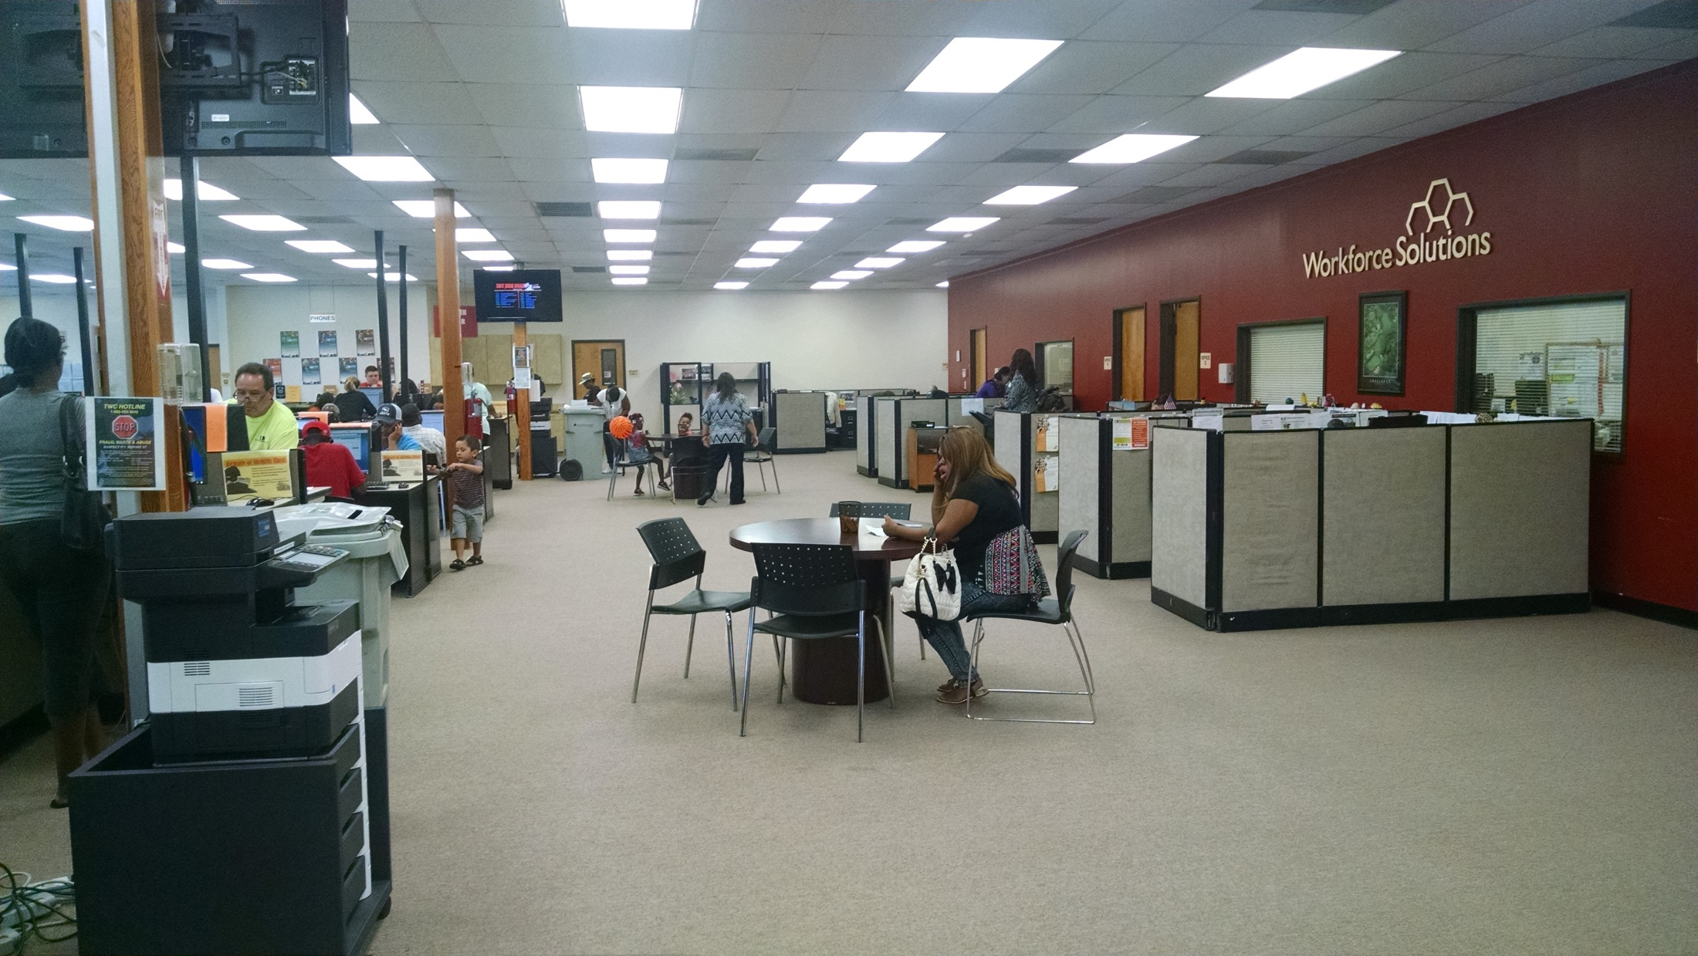

Slide 12
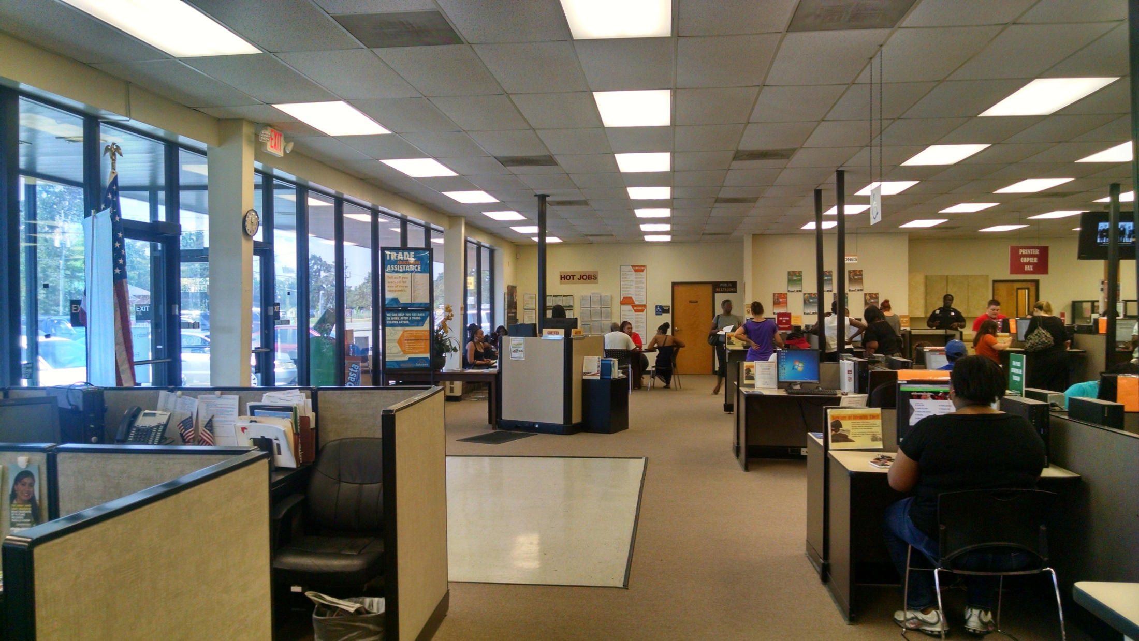

Slide 13
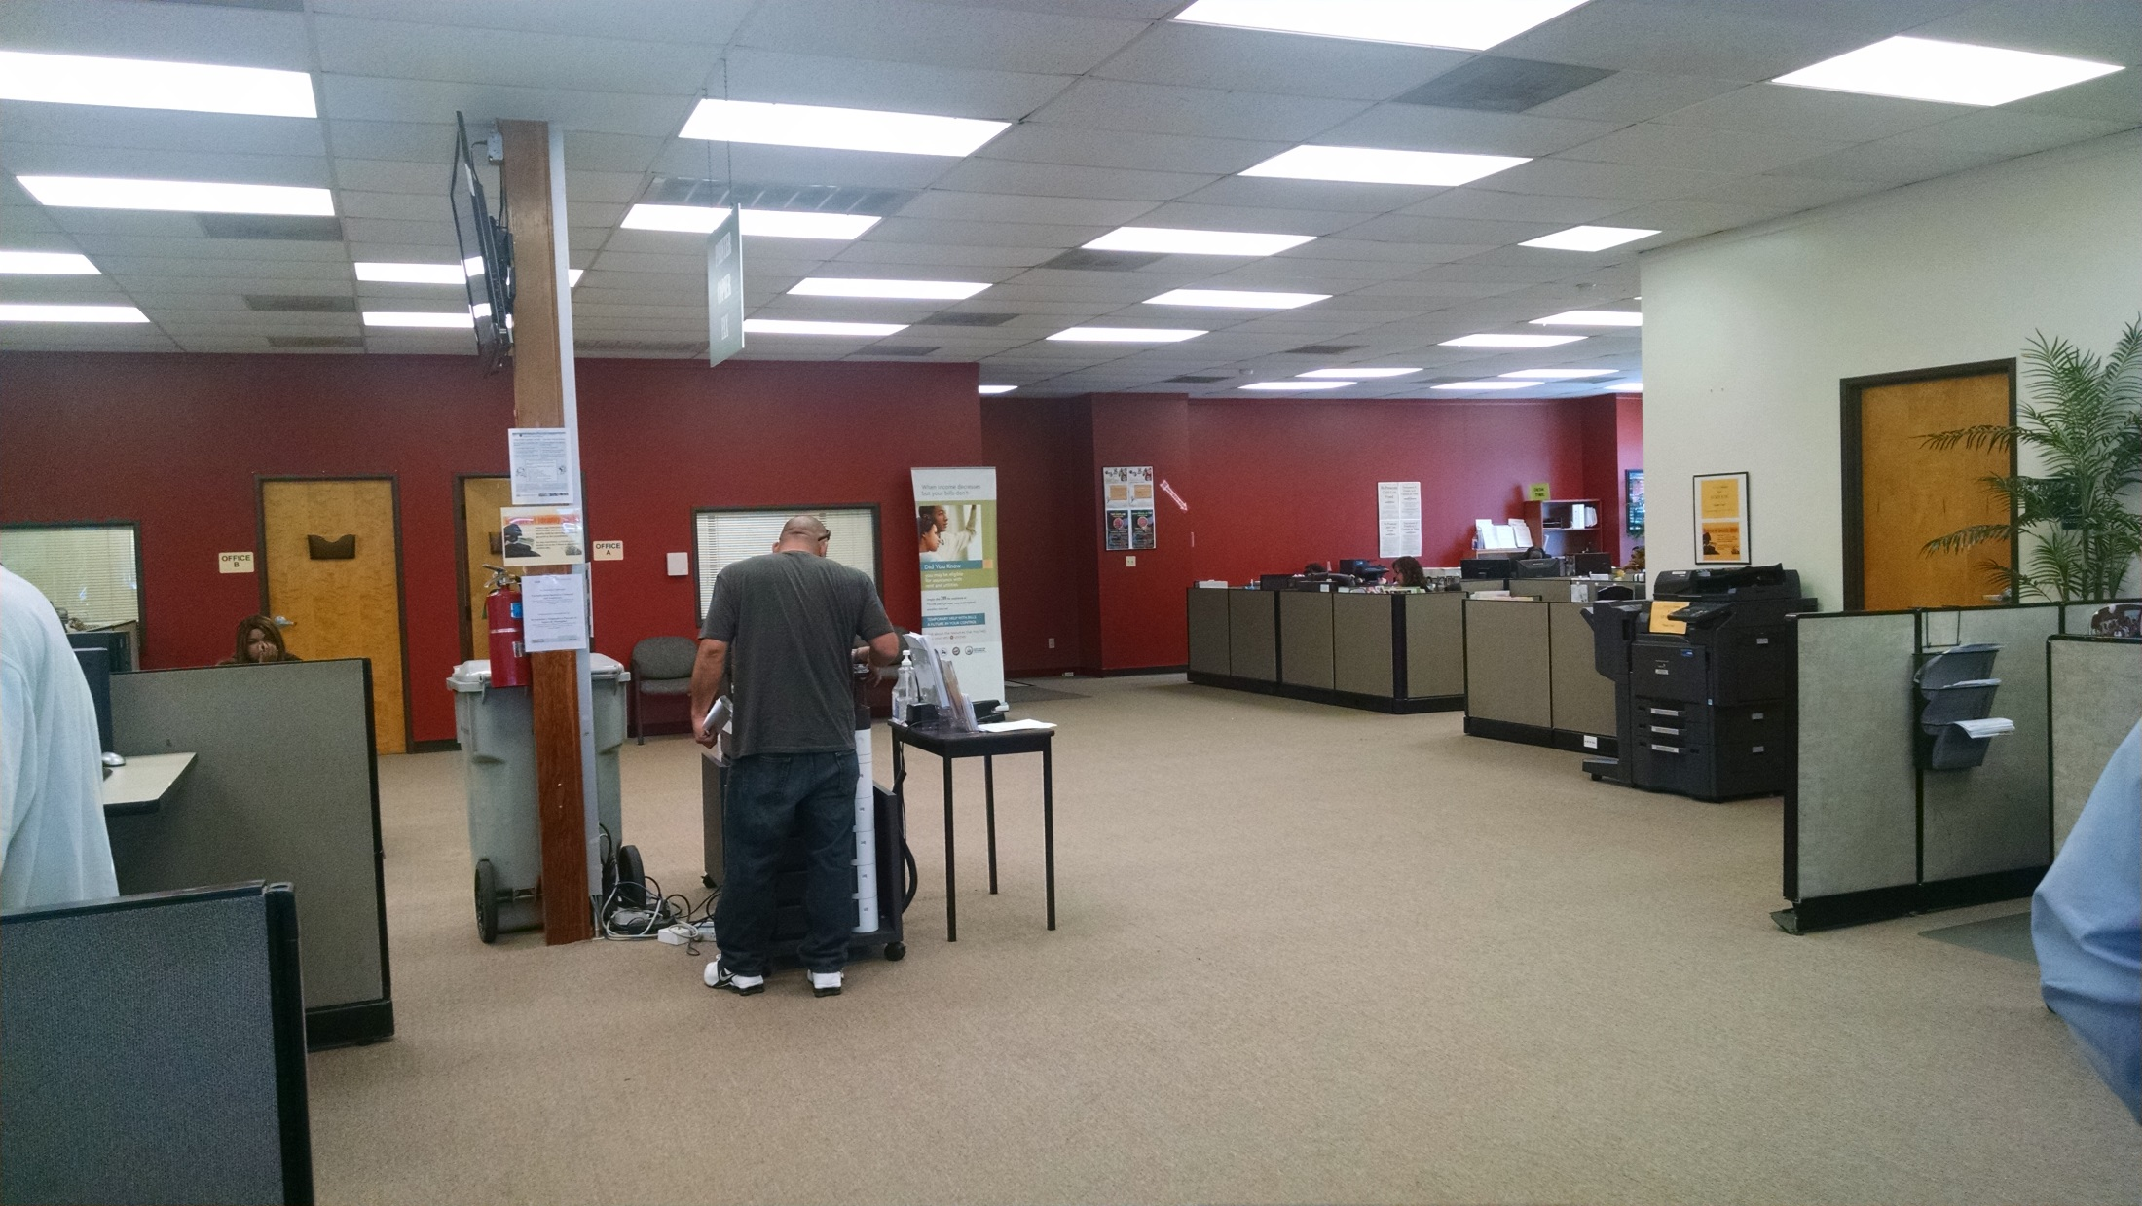

Slide 14
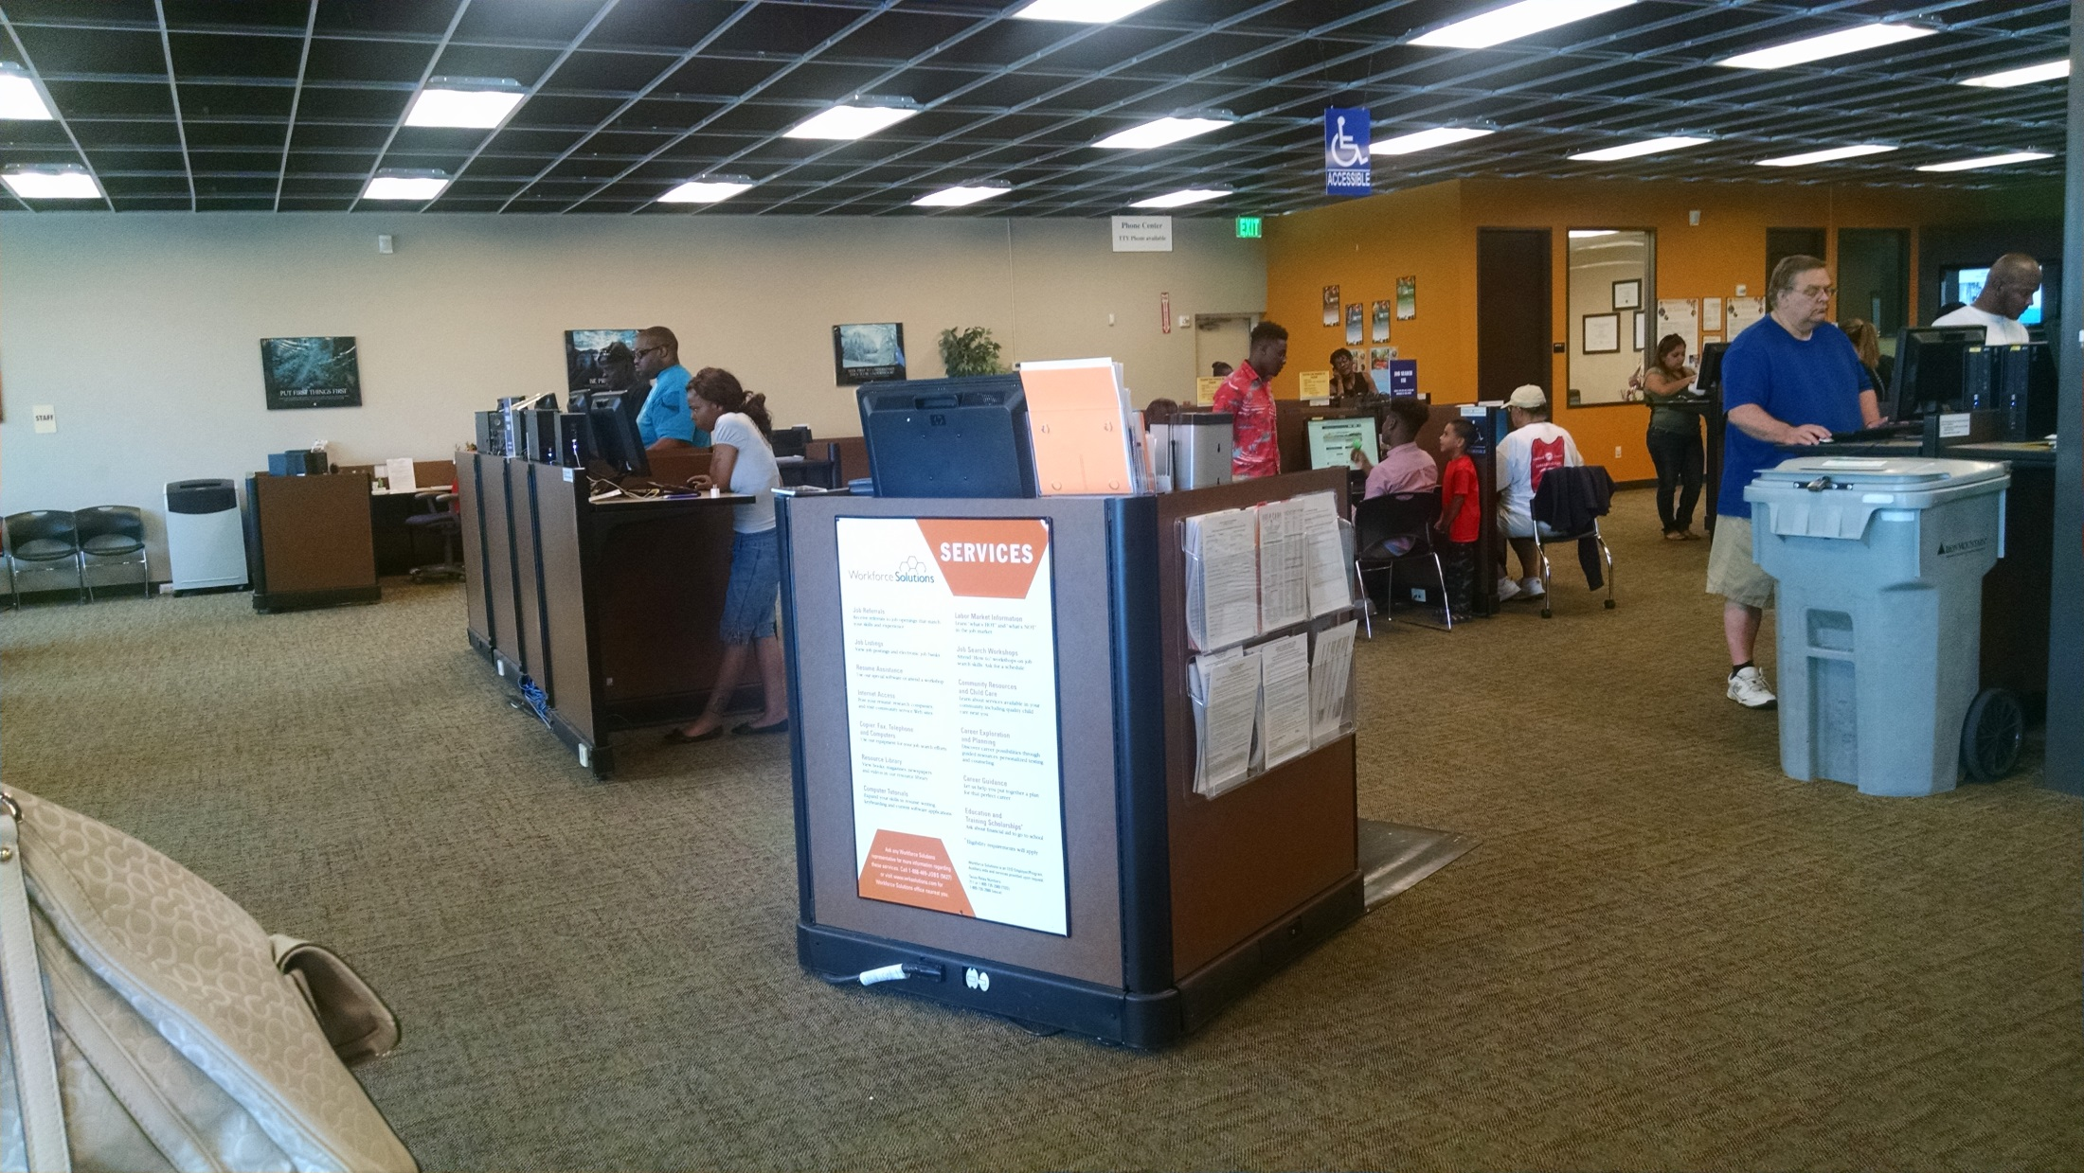

Slide 15
The Four Services
Exploratory
Career
Training
Business

Slide 16
Welcome
Team
(6)
Exploratory Services
(3.5)
Career
Services
(3.0)
Skills
Team
(3)
Training
Services
(4.0)
Business Team
(4)
Business
Services
(2.5)
Notes:
This represents the transition from three teams to four services.
Popcorn is FTE set free and then re-assigned to services.
Hopefully this is a time for assessing staff interests and placing people in assignments that best fit their strengths and talents.
FOR OED STAFF:
New position description that aligns with new model
IDP for all staff to transition into the new model

Slide 17
Exploratory Services
Greeting the customer within a minute: All customers entering a center will be greeted within one minute. Greeters will query/speak with customers about their reason for coming into the center. After greeting and listening to customer needs, staff will inform customers of available services and propose options toward next steps.
One-on-One: Customers needing to register with the labor exchange system, or interested in pursuing Career or Training Services will be provided a customized one-on-one engagement no more than 15 minutes after the initial greeting. At the one-on-one, staff will review, assist with, or conduct basic registration; provide additional information about available services; listen to customer needs; and provide guidance on next steps based on needs and interests.
Next Steps: Each time customers engage in services, appropriate customer information/data is collected and next steps are planned and scheduled.
Notes:
Basic Registration:
Currently (June 26, 2015) under development.
More information to follow.

Slide 18
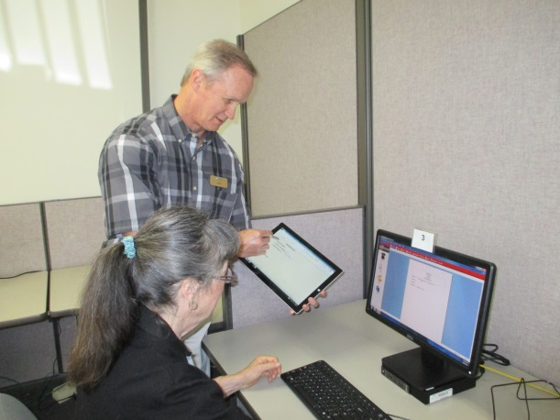
Customer-Centric Service
WSO Klamath Falls, WSPM Beaverton-Hillsboro, and WSO Lane pilot a new customer service process that provides immediate service to customers based on their need.

Slide 19
WorkSource Lane’s Pilot Project
https://wsostandards.weebly.com/exploratory-services1.htm
l

Slide 20
WorkSource Oregon Greeter Competencies
Customer Focused
Creates a positive customer experience
Strives for customer satisfaction
Delights the customer
Decision Making
Critical thinking skills
Problem solving skills
Teamwork
Ability to build rapport
Collaborative
Inclusive
Adaptability
Adaptable to change
Ability to learn quickly
Promotes continuous improvement
Motivation
Positive Attitude
Self-Manager
Displays energy and enthusiasm
Communication
Active and Effective Listening skills
Ability to influence others
Excellent communication skills
Personal Responsibility
Possess interpersonal skills
Presents oneself professionally
Knows when to use humor
Integrity
Respectful of others
Maintains sensitive information

Slide 21
Career Services
Career Services are those services that assess a person’s readiness to work and provide employment statistics information to inform career goals and opportunities for advancement in occupations.
Career Services include:
Management of work-ready talent pools
Job Search
Placement Assistance
Skill Validation
Career Counseling
Provision of information on in-demand industry sectors and occupations
Provision of information on non-traditional employment
Feedback mechanism to evaluate the quality of candidates referred to business
Effective Career Services rely on assessment, development of a focused Individual Employment Plan (IEP), career planning and skills validation.
Notes:
Skills Validation:
Prior to referral staff will verify: intent to work/motivation, work history, employer-required licenses, credentials and hard skills, and essential skills/soft skills.

Slide 22
Training Services
Individuals determined to be in need of training to obtain or retain employment that leads to economic self-sufficiency or wages comparable to or higher than wages from previous employment may be eligible to receive Training Services.
Adult Education and Literacy: Activities of English language acquisition, integrated education and training programs, and workforce preparation activities (as defined under Title II) will be available through WSO centers.
Talent Development: Talent Development increases capacity for someone to learn and/or demonstrate work-related skills. All centers will offer staff-assisted talent development workshops to teach essential skills for work readiness including (at a minimum): résumé development, basic computer skills, interviewing skills, networking/social media use, and soft skills.
Skill Development: Though types and amounts may vary, all local areas will provide skill development based on structured, written curriculum designed to address gaps, develop new skills and advance toward attainment of industry-recognized and post-secondary credentials.
Work-Based Learning: Work-Based Learning includes On-the-Job Training (OJT), apprenticeship, and work experiences and internships that are linked to careers. Work-Based Learning services may also include job shadows, volunteer opportunities, and career exploration to help customers develop skills, experience and/or exposure to careers or industries based on their interests and competencies.
Notes:
TRAINING SERVICES
Individuals determined to be in need of training to obtain or retain employment that leads to economic self-sufficiency or wages comparable to or higher than wages from previous employment may be eligible to receive Training Services. Local areas may also prioritize training connected to sectors and target populations as part of the local plan, and will create opportunities for remediation.
The workforce system is expected to increase investment in certifications that help people get jobs, and support the development and documentation of functional skills. There has been growth in the variety of skill building tools including on-line training and credentials, certification of new and existing skills, and work-based learning. All WSO centers are expected to build these types of tools into the menus of available training services and activities.
An IEP is required for all customers accessing Training Services. The IEP will be used to inform training needs, as well as to verify whether or not customers have the skills to be successful in training prior to enrollment into the training program.
Mechanisms must be in place to monitor the quality and effectiveness of training services both from outcome data and business/customer feedback. The feedback loop established for local areas should be comprehensive processes where: training services communicate the available talent to placement services, placement services seek businesses input regarding the quality of candidates and local training needs, placement services market qualified candidates to targeted business customers and placement and business services inform training content based on the input received from employers. Local Boards will serve as a primary source of business intelligence to inform center priorities and investment strategies around training services.
Among Training Services available, there are categories of Adult Education and Literacy, Skill Development, Talent Development, and Work-Based Learning. How these services are delivered and made accessible to customers is dependent upon local plans.
Adult Education and Literacy
Adult Education and Literacy activities; including activities of English language acquisition, integrated education and training programs, and workforce preparation activities (as defined under Title II) will be available through WSO centers. These activities may be provided concurrently or in combination with other services. The frequency and intensity is dependent upon local plan strategies and customer demand.
Talent Development
Talent Development increases capacity for someone to learn and/or demonstrate work-related skills. All centers will offer staff-assisted talent development workshops to teach essential skills for work readiness including (at a minimum): résumé development, basic computer skills, interviewing skills, networking/social media use, and soft skills. Talent development activities will comply with Core Talent Development Criteria included here as Appendix B. Talent Development activities may also include short-term pre-vocational services, including development of learning skills, communication skills, interviewing skills, punctuality, personal maintenance skills, professional conduct, and financial literacy.
Talent Development services are essential to the development of Certified Work Ready Communities, involving attainment of NCRCs and soft skill assessment. All WSO centers will offer NCRC preparation assistance, and NCRC testing on-site for customers.
Talent development workshops and activities will be required of participants assessed as lacking work readiness skills prior to receiving a staff referral for employment. Local areas will have processes in place to manage this expectation.
Skill Development
Though types and amounts may vary, all local areas will provide skill development based on structured, written curriculum designed to address gaps, develop new skills and advance toward attainment of industry-recognized and post-secondary credentials. All centers will have online skills development tools available for customers (links to resources) in addition to in-person training, both of which will be delivered by approved providers, including local community colleges. Skill Development primarily involves organized programs of study that provide education and vocational skills that lead to proficiency in performing functions required by certain occupational fields at entry, intermediate or advanced levels, or leads to credentials required by employers in the occupational field (defined as Individual Training), and also includes skill upgrades; retraining; entrepreneurial training; and occupational skills training—including training for nontraditional employment. Staff will assist jobseekers with assessing and accessing these services and may be engaged in monitoring and testing to measure customer progress.
Work-Based Learning
WIOA aims to create job-driven centers that focus on work-based learning, industry-recognized/postsecondary credentials, career pathways, and enhanced connections to registered apprenticeship. All centers will make work-based opportunities available to customers in accordance with local area plans and investment strategies.
Work-Based Learning includes On-the-Job Training (OJT), apprenticeship, and work experiences and internships that are linked to careers. Work-Based Learning services may also include job shadows, volunteer opportunities, and career exploration to help customers develop skills, experience and/or exposure to careers or industries based on their interests and competencies. Work experiences that are linked to careers will be provided at all WSO centers.
Work-based learning opportunities should be marketed by both training and business service staff. Staff will pursue opportunities with employers and make appropriate referrals for work-ready jobseekers.
Local Boards will coordinate work-based learning opportunities across partner agencies to ensure maximization of employer contact and avoid business-contact fatigue. Local Boards will research opportunities and develop relationships with local businesses and partners (including apprenticeship programs and training centers) to make these training models available to customers. In accordance with standards described under Career Services above, feedback mechanisms between Training Services and placement functions must be in place to ensure that the training being provided is meeting the needs of business.

Slide 23
Core Talent Development Workshops
All centers will offer staff-assisted talent development workshops to teach essential skills for work readiness including (at a minimum):
Résumé Development
Basic Computer Skills
Interviewing Skills
Networking & Social Media
Soft Skills

Slide 24
Business Services
The most important Business Service WSO provides is connecting employers to qualified candidates.
Recruitment Services: Recruitment involves attracting, selecting and referring suitable candidates to one or more jobs through multiple activities that are customized to a specific employer or occupational need. WSO staff conducting Recruitment Services will work closely with staff providing career and training services to access the appropriate talent pool for the position(s) being recruited. Recruitment Services include job postings and promoting employment incentives to business.
Customized Training: Customized training may be provided, in alignment with local plans and available resources, to meet the specific skill needs of local employers. The training is conducted with a commitment by an employer or group of employers to employ an individual upon successful completion of the training.
Incumbent Worker Training: Local boards may reserve funds to pay for the federal share of the cost of providing training through an incumbent worker training program.
Rapid Response: The mission of the pre-layoff system in Oregon is to provide comprehensive information and technical assistance leading to employment of dislocated workers affected by layoff, closure and/or disaster. Rapid Response activities are time-sensitive and all LLTs will develop local protocols to ensure contact with affected parties within 48 hours of receiving notice of a layoff, closure or crisis event.

Slide 25
WSO Job Seeker Customer Flow
Jobseeker
Enters
WSO
Exploratory
Service
Career Service
Training
Service
Business
Service
Greet
Listen
Assess
Direct
Listen to Customer
Assess Need(s)
Explain WSO Services
Next Steps
Assessment
Career Counseling
Skills Validation
Job Search
Job Placement
Talent Development
Adult Education/Literacy
Skill Development
Work-Based Learning
Recruitment Services
Job Listings
Customized Training
Incumbent Workers
Hiring Incentives
Rapid Response
Registration occurs as needed across services
Feedback Mechanism
Notes:
REVIEW: WE’VE SEEN THE NEW CUSTOMER SERVICE APPROACH, REFERRED CUSTOMERS TO THE APPROPRIATE SERVICE TO BECOME JOB READY. NOW THEY ARE READY FOR PLACEMENT BY USING VETTED TALENT POOLS.

Slide 26
Business Customer Flow
WSO Employer Customer Flow
1 2 3 4 5
Hiring Employer and WSO Connect
WSO Tours Worksite, Consults
WSO Tours Worksite
WSO Tours Worksite
WSO Searches Talent Pool to Refer
WSO Searches Talent Pool to Refer
Employer Connects with
WSO
WSO Searches Talent Pool to Refer
Employer Connects with
WSO
WSO Enters Job Listing
WSO Enters Job Listing
WSO Enters Job Listing
WSO Refers Quality, Job-Ready Candidates
Employer Interviews Candidates
Employer Makes Hiring Decision
Employer Informs WSO of Hiring Decision
WSO DocumentsHire and Asks about Other Openings
Business Completes Satisfaction Survey
Talent Pool
6 7 8 9 10
Established Talent Pool Is Continuously Managed by WSO Centers

Slide 27
Planning is Underway Everywhere
State map
Quick summary of planning
Notes:
Local areas are leading implementation of the Standards.
Areas are starting a different stages:
Some areas are forming new boards
New leadership teams are being formed
Deeper connections between partners are developing
The State’s role (OED/CCWD/DHS)

Slide 30
https://wsostandards.weebly.com

Slide 31
Serving REA Customers and
Meeting the 15-Minute Standard
Q: Can we spend up to 70-minutes for each REA customer?
A: Yes.
Q: Are we expected to spend 70-minutes with each REA customer?
A: No, we don’t need to spend 70 minutes with each REA customer. 70 minutes is an average. Some interviews may be 20 minutes and some interviews may be 120 minutes. It depends on the customers’ needs.
Q: How do I know how much time to spend with each REA customer?
A: By assessing their needs at the time and providing services that meet their need(s). When in doubt, think customer-centric.

Slide 32
WSO Operational Standards Technical Support
Danell Butler
(503) 378-8026
danell.l.butler@oregon.gov
Robert Brown
(503) 947-1305
robert.b.brown@oregon.gov
Debi Welter
(503) 947-3032
debra.a.welter@oregon.gov

